Slide 1

2022 Security Conference
How to Keep Your Data Secure in The Digital Age

Slide 2
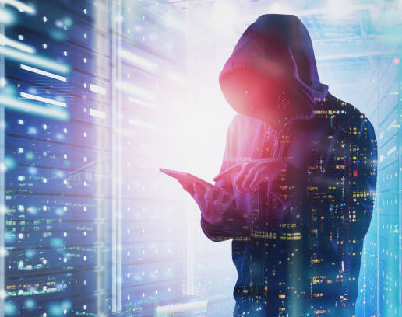
Why is Information Security Important?
Personal data is a valuable, yet less secure commodity.
Your cell phone and computer know everything about you: Your name, social security number, and even your bank account information.
This is great news for identity thieves, as all your personal information is in one place.

Slide 3

Did You Know?
As per the Federal Trade Commission, ransomware attacks have increased by 311% from 2019 to 2020.

Slide 4
How to Keep Your Data Safe: Secure Your Password
Longer passwords are best. You should include symbols and numbers to increase the complexity of your password.
Writing down your password is not recommended. If you need to write down your password, keep it in a locked drawer where no bad actors can access it.
Consider a password generator, which would give you a completely random password.
You can store your password in BitWarden if you cannot remember it.

Slide 5
Make Your Computer Inaccessible
Lock your computer when away from your desk (press CTRL + ALT + DEL, then click “Lock”).
Turn your computer off when finished for the day.
Make sure your sensitive documents are password locked. Other employees should have “read only” privileges.

Slide 6
Verify Identities
Make sure the sender’s email address is spelled correctly.
If a caller is asking for sensitive information and you cannot confirm their identity, DO NOT give it to them. It’s better to have him/her to ask you in person.
Do not open any suspicious looking email or tickets. Malware can be installed on your computer by the simple click of a link.

Slide 7
Lock Up Your Information
Back up your data to the cloud when possible.
Make sure your virus scanner is on and periodically checking for threats.
Leave your firewall on AT ALL TIMES. You can allow a website to bypass your firewall ONLY when the website is trusted.
Do not email sensitive information if possible. Use Gmail/Outlook’s encryption services if you must send sensitive information through email.

Slide 8
Other Useful Tips
Update your Windows operating system when one is available.
Make sure the name of the WIFI is correct.
Check for any spelling errors in a web address.
NEVER post sensitive information about the company on social media without permission.
Ask the IT department if something looks suspicious.

Slide 9

When to Reach Out For Support
If you believe your sensitive data has been compromised, notify IT immediately. Response time is crucial in these kinds of situations.
If we can deal with the threat before data gets taken and sold, then we can save the reputation of Flogistix as well as your identity.
Always remember that great information security starts with you.

Slide 10
Questions, feedback, or concerns?

